Slide 1
The Material Selection Process So many choices, so little time.
How to select mechanical materials for prototypes and production devices
Presented by
Neil B. Kimerer, Jr. P. E.
To the Williamsport Inventers Club
January 28, 2015

Slide 2
Overview
Discuss the selection Process
Discuss the properties of materials
Discuss material groups
Discuss metal materials
Discuss Plastic materials
Discuss composite materials
Give some examples
Discuss Additive Manufacturing Materials

Slide 3
Basic Process Steps an elimination process
Define the environment
Select groups of materials that meet the requirements
Define the material’s mechanical property requirements
Select materials from the environmental groups that meet the requirements
Select a manufacturing process from the material candidates
Select from the candidates for cost
Select from the mechanical properties group the lowest cost material

Slide 4
Define the Environment
There are two types of environments
Survival Environment
An environment the product might be exposed to but it does not have to function while in it.
Operating Environment
An environment where the product must be able to function properly.

Slide 5
Environment Characteristics that need to be considered
Temperature (Changes the properties of materials.)
Gas exposure (corrosion, oxidation, etc. Especially when two different metals are in direct contact with each other. gas, such as the atmosphere, liquids, such as water and sea water, Oils, etc.)
Liquid exposure (generally more active than gases. Especially when two different metals are in direct contact with each other.)
Electromagnetic wave exposure (Visible light, Ultra violet light, Infrared light, X-rays, micro waves, Microwave ovens, etc.)
Electric current (AC fields can induce currents in conductive materials.)
Pressure (atmospheric, underwater, water lines, water heaters, engines, steam and internal combustion)
Radio active particle fields ( Necular reactors, radiation treatment machines, X-Ray machines, devices lifted to high altitudes above the earth devices lowered into deep holes drilled into the Earth’s crust, etc.)
Magnetic fields (around electric motors, Transformers, generators, MRIs, etc.)
Consequences of the part failure
Time (materials deteriorate with time alone, plastics, concrete, wood, silk, etc.)
Shock (shock and vibration can cause grain boundary separations, plastic deformations, fracture, crakes, etc.)

Slide 6
Defining Material Mechanical properties (all solid materials)
Stiffness (modulus of elasticity, Young’s modulus, PSI)
Strength (yield, ultimate and endurance stress, PSI)
Bulk Modulus (compression, PSI)
Shear Modulus (resistance to shearing, PSI)
Poison's ratio (inches/inch, dimensionless)
Ductility (amount of yielding before failure, inches/inch, dimensionless)
Thermal coefficient of expansion (inches/inch/ º F)
Density (pounds/cubic inch)
Transparency
Hardness (resistance to denting and wear, empirical, HR, B)
Conductivity (electrical, Ohms/in, and thermal, BTU/hour-feet/ º F)
Magnetic permeability (sensitivity to magnetic fields)
Shock resistance ( how brittle is the material ?)
Notch sensitivity to fracture
Specific Heat Capacity (BTU/pound)
Creep
Melting point ( º F)
Freezing point ( º F)

Slide 7
Where to find a materials properties
www.matweb.com
Free to the buyer
Several selection methods
Sends you to sellers on request
Ceramics - 8166 materials (matls)
Fluids – 5494 matls
Engineered – 5140 matls
Metals - 14,540 matls
Polymers – 78,836 matls
Natural – 381 matls

Slide 8
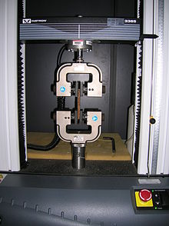
Tensile Testing Machine
This test defines the strength and stuffiness of a material
These machines measure the applied force and the distance traveled
Hook’s Law Force = K * ΔL
This machine allows us to calculate K
K = Force/ΔL

Slide 9
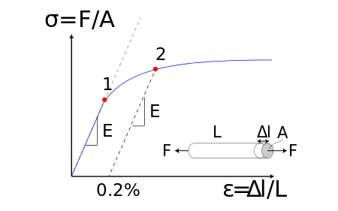
Defining stress and strain in materials
Stress – Stretching a material induces stress into the material
Stress is the measured change in length of the material divided by the original length
Strain is the applied load divided by the area of the material’s crossection carrying that load
A stress strain curve is the plot of the induced stress on the X axis verses the induced strain on the Y axis using a Cartesian coordinate system
Hook’s Law – linear stress vs. strain relationship over the elastic range of the material. The material will return to its original shape when the load is removed.
Stress-Strain curve

Slide 10
More Material property definitions
Yield stress at 2
Ultimate stress at 3
Lower curve does not account for the change in the crossectional area
Upper curve takes the change in area into account

Slide 11
Bulk Modulus
Bulk Modulus is the equivalent to Young’s modulus except in compression
Units in the English system are PSI

Slide 12
Shear Modulus
A materials resistance to a shearing force.
Shear modulus is directly related to the other moduli.
If you know the Poisson’s Ratio, Bulk modulus and Young’s modulus the Shear modulus can be calculated.

Slide 13
Poisson’s ratio (ν)
The ratio of the change in width divided by the change in length in the elastic range of the material.
Constant volume law.
Theoretical maximum value is 0.5
Most metals are around 0.3

Slide 14
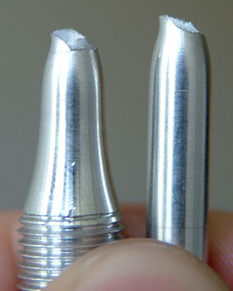
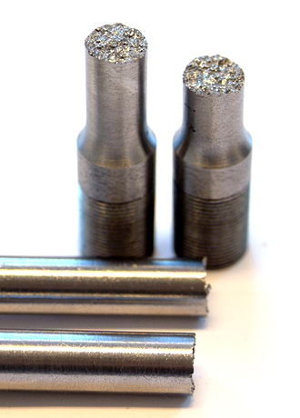
Ductility
Ductility (in tension)
Malleability (in compression)
Depends on the metal treatment

Slide 15
Thermal Coefficient of Expansion
Thermal coefficient of expansion (inches/inch/ º F)
Magnesium ≈ 14.5 x 10 ⁻⁶
Aluminum ≈ 11.7 x 10 ⁻⁶
Copper ≈ 9.4 x 10 ⁻⁶
Steel ≈ 6.4 x 10 ⁻⁶
Titanium ≈ 4.6 x 10 ⁻⁶

Slide 16
Density
Weight per unit volume
Magnesium ≈ 0.063 lbs./ inch ³
Aluminum ≈ .100 lbs./inch ³
Titanium ≈ 0.160 lbs./inch ³
Steel ≈ 0.278 lbs./ inch ³
Copper ≈ 0.310 lbs./ inch ³
Lead ≈ 0.4097 lbs./ inch ³
Lead is 6.5 times as dense as Magnesium

Slide 17
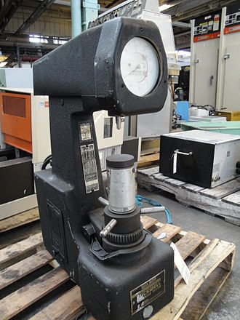
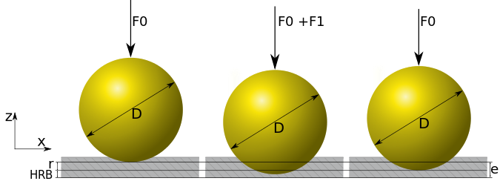
Material Hardness
Metal Hardness (resistance to denting) – Rockwell (HR) and Brinell (B) scales
Empirical measurement
Rockwell A, B and C
Brinell
Rubber like materials Hardness – Shore Durometer scale
Empirical measurement

Slide 18
Rockwell Hardness Scales
Scale | Abbreviation | Load | Indenter | Use
A | HRA | 60 kgf | 120° diamond cone† | Tungsten carbide
B | HRB | 100 kgf | ¹⁄₁₆-inch-diameter (1.588 mm) steel sphere | Aluminum, brass, and soft steels
C | HRC | 150 kgf | 120° diamond cone | Harder steels >B100
D | HRD | 100 kgf | 120° diamond cone
E | HRE | 100 kgf | ¹⁄₈-inch-diameter (3.175 mm) steel sphere
F | HRF | 60 kgf | ¹⁄₁₆-inch-diameter (1.588 mm) steel sphere
G | HRG | 150 kgf | ¹⁄₁₆-inch-diameter (1.588 mm) steel sphere
†Also called a brale indenter

Slide 19
Conductivity (electrical, Ohms/in, and thermal, BTU/hour-feet/ º F)
Electrical
Conducting current, transformers, motors, inductors, grounding
Eliminating conduction, insulation for wires, electrical isolation mounts,
Thermal
Heat exchangers for cooling or heating
Insulation for retaining heat or cold

Slide 20
Other properties
Magnetic permeability (sensitivity to magnetic fields)
Shock resistance ( how brittle is the material )
Notch sensitivity to fracture
Specific Heat Capacity (BTU/pound)
Creep
Melting point ( º F)
Freezing point ( º F)

Slide 21
Selecting the Material Category
Discuss mechanical properties
Homogeneous Materials (Isentropic)
Have the same properties in all directions
Composites (non-homogeneous, anisentropic) Materials
Has directional dependent properties
Strain - stiffness
Stress - Strength (load carrying capacity)

Slide 22
Define the material’s mechanical property requirements
Requires two conditions
Loading
shape
How stiff?
How strong?
How hard?
How tough?

Slide 23
Cost Has two components
Material cost
Cost of material required
Processing cost
Cost required to turn the material into a part
tooling
Processing (including Specifications for Geometric Dimensioning and Tolerancing or GD&T)
Total cost = Material cost + Processing cost

Slide 24
GD&T Drawing Example
Dia = 1.00 Dia = 1.00 ±.02
Dia = 1.000 Dia = 1.000 ±.002
Dia = 1.0000 Dia = 1.0000 ± .0002
Not the same dimension on a
Drawing.
ASME Standard
Dimensioning and Tolerancing Y14.5 - 2009

Slide 25
Material Groups
Homogeneous Materials
(Isotropic - the same properties in all directions)
Metals
Ferrous – iron based
Hard – steel, chromium, nickel, carbon in iron
Soft – aluminum, magnesium, lead
Polymers
Plastics
Rubber
Epoxy
Ceramics
Composite Materials (Nonhomogeneous)
(Anisotropic – different properties in different directions)
Wood
Fiberglass composite
Carbon fiber composite
Boron fiber composite
Concrete
Reinforced concrete
Natural stone

Slide 26
Processing shaping the material into a part Tooling + processing costs
Machining (subtractive manufacturing, turning, cutting, milling, grinding)
Welding (fixtures some times required)
3D printing (Addative manufacturing, SLA, SLS, FDM, printing )
Plastic forming with and without heat( Bending, stamping, pressing)
Casting (sand casting, investment casting, centrifugal casting)
Extruding
Molding (injection, pored)
Forging
Hydro-forming
Explosive bonding and forming

Slide 27
Metals
Matls – Metals in the mix only – does not define properties
Properties come from the Materials and the processing (cold working, heating, cooling rate, heat treatments, etc.)
Both must be specified to get the desired material

Slide 28
Metal Numbering Systems
AISI- AMERICAN IRON AND STEEL INSTITUTE
SAE- SOCIETY OF AUTOMOTIVE ENGINEERS
ASTM- AMERICAN SOCIETY FOR TESTING MATERIALS
ANSI- AMERICAN NATIONAL STANDARDS INSTITUTE
AA- ALUMINUM ASSOCIATION
CDA- COPPER DEVELOPMENT ASSOCIATION
MIL-SPECS- MILITARY SPECIFICATIONS {DOD}
FED-SPECS- FEDERAL SPECIFICATIONS {GAO}
ISO- INTERNATIONAL STANDARDS ORGANIZATION
UNS- UNIFIED NUMBERING SYSTEM
AMS- AEROSPACE MATERIAL SPECIFICATION
AWS- AMERICAN WELDING SOCIETY
TRADE NAMES- i.e. MONEL, MUNTZ METAL, GUN METAL
COMPANY NUMBERING SYSTEMS- i.e. G.E., NASA
DIN - DEUTSCHES INSTITUT FüR NORMUNG ( GERMAN )

Slide 29
UNS Numbering System
UNIFIED NUMBERING SYSTEM.
1. Was developed through joint effort of the ASTM and SAE to provide a means of correlating the different numbering systems for metals and alloys that have a commercial standing.
2. Is not a specification for strength. It does specify the mixture. (the metals used in the alloy).
3. It is an identification number for metals and alloys where specifications are provided elsewhere.
4. Has letter prefix followed by five digits. The letter can be suggestive of family of metals, such as A-aluminum or C-copper.
UNS SERIES METAL
NON FERROUS METALS + ALLOYS

Slide 30
UNS definitions
UNIFIED NUMBERING SYSTEM.
UNS SERIES METAL
NON FERROUS METALS + ALLOYS
A00001 to A99999 ALUMINUM AND ALUMINUM ALLOYS
C00001 to C99999 COPPER AND COPPER ALLOYS
E00001 to E99999 RARE EARTH+R.E. LIKE METALS L00001 to L99999 LOW MELTING METALS + ALLOYS
M00001 to M99999 MISC.NON FER. METALS + ALLOYS
N00001 to N99999 NICKEL AND NICKEL ALLOYS
P00001 to P99999 PRECIOUS METALS AND ALLOYS
R00001 to R99999 REACTIVE,REFRACTORY METALS
Z00001 to Z99999 ZINC AND ZINC ALLOYS
FERROUS METALS AND ALLOYS
D00001 to D99999 SPECIFIED MECH PROPERTY STEELS F00001 to F99999 CAST IRONS
G00001 to G99999 AISI + SAE CARBON ALLOY STEELS H00001 to H99999 AISI H STEELS
J00001 to J99999 CAST STEELS {EXCEPT TOOL STL}
K00001 to K99999 MISC. STEELS + FERROUS ALLOYS
S00001 to S99999 HEAT + CORROSION RESIST. STEEL T00001 to T99999 TOOL STEELS

Slide 31
UNS and AISI Ferrous Metal Designations
D00001 to D99999 SPECIFIED MECH PROPERTY STEELS F00001 to F99999 CAST IRONS
G00001 to G99999 AISI + SAE CARBON ALLOY STEELS H00001 to H99999 AISI H STEELS
J00001 to J99999 CAST STEELS {EXCEPT TOOL STL}
K00001 to K99999 MISC. STEELS + FERROUS ALLOYS
S00001 to S99999 HEAT + CORROSION RESIST.
STEEL T00001 to T99999 TOOL STEELS
1018
4340
17-4ph
300 stainless
400 stainless
$2 -$2.50 / pound structural steel
Like a Cake – better ingredients make a better cake and cost more money

Slide 32
A00001 to A99999 ALUMINUM AND ALUMINUM ALLOYS
1000 – pure aluminum
2000 – Aluminum + copper +Mn+Mg
6000 – Aluminum + copper+ Mn + Mg
7000 - Aluminum +copper+?
$ 2.45 - $2.60 / pound
1040 – ductal, siding, downspouts, roof flashing
2024 – Airplanes, ladders, cars
6061 – Where higher strength is required, aircraft
7075 – High strength, brittle, special aircraft parts

Slide 33
C00001 to C99999 COPPER AND COPPER ALLOYS
1000 – pure copper
Brass – Copper and Zinc
Bronze – Copper, Tin and Arsenic
Beryllium copper $ 100 - $110 / pound
$ 3.00 - $3.50 /pound
Electric wires, motor and transformer windings
Mechanical parts, gears, bearings
Bronze, similar to brass
C-17000 High strength parts, conducting springs, undersea housings, load-cells

Slide 34
Titanium
High temperature applications
High strength to weight ratio requirements
Titanium Ti-6Al-4V (Grade 5)
$ 40.00 / pound
Aircraft (SR-71) and human replacement body parts
Yield strength 140 KSI

Slide 35
Magnesium
AM 100A-T5, CAST – Magnesium, aluminum, 70, 10
Magnesium AZ31B-H24, Hard Rolled Sheet – Magnesium, Aluminum, 97,03
$ 4.60 - $ 5.00 / pound
16,000 K PSI yield
31,900 K PSI yield

Slide 36
Stainless Steel
300 series – Iron, Chromium, Nickel
400 series – Iron, Chromium
Precipitation Hardened series (17-4 Ph, 15-5 Ph, etc.) – Iron, Chromium, Copper, (special heat treatments to create the phase structures)

Slide 37
Thermal Plastics (Plastic)
Polyethylene Terephthalate (PET, PETE, Type #1 plastic)
Poly-ethylene (PE, HDPE Type #2 plastic)
Poly-Vinyl-Chloride (PVC, Type #3 plastic)
Poly-ethylene (LDPE, Type #4 plastic)
Poly-propylene (PP, Type #5 plastic)
Poly-styrene ( Type #6 plastic)
Nylon
Acrylonitrile butadiene styrene (ABS)
Acetyl (Delrin?)
Thermoplastic elastomer (TPE)
Poly-carbonate
Teflon
Epoxies
PC

Slide 38
Why Plastics?
Derived from petroleum
Cost of materials lower
Processing cost MUCH lower
Lower temperatures, lower pressures, easier to machine, tooling costs lower
Some are transparent (PC for example) and can be used as lenses

Slide 39
Polyethylene Terephthalate PET, PETE, Type #1 plastic
Common plastic – Disposable items, must be inexpensivewater bottles, soda bottles, etc.
Yield strength 5000 – 10,000 PSI
Young’s Modulus – 400 K PSI
Melts around 480 º F

Slide 40
Poly-ethylene PE, HDPE Type #2 plastic
Toys, common plastic parts, plastic bottles, plastic bags
Yield strength between 3000 – 5000 PSI
Young’s Modulus – 330 K PSI
Melts around 375 º F
Elongation at failure – 500 %

Slide 41
Poly-Vinyl-Chloride PVC, Type #3 plastic
Plumbing pipes, deck boards, porch railing, siding, water bed mattresses
Yield Strength – 4000 PSI
Young’s Modulus – 425 K PSI
Melting point – 360 º F
Elongation at failure – 350 %

Slide 42
Low Density Poly-ethylene LDPE, Type #4 plastic
Squeezable plastic bottles, industrial netting, woven tote bags
Yield Strength – 2500 PSI
Young’s Modulus – 50 K PSI
Melting point – 380 º F
Elongation at failure – 250 %

Slide 43
Poly-propylene PP, Type #5 plastic
Rope, cord
Yield Strength – 25,000 PSI
Young’s Modulus – 600 K PSI
Melting point – 285 º F
Elongation at failure – 450 %

Slide 44
Poly-styrene Type #6 plastic
Packaging material
Yield Strength – 16,200 PSI
Young’s Modulus – 1500 K PSI
Melting point – 570 º F
Elongation at failure – 1.5 %

Slide 45
Type # 7 Plastics
Nylon
Acrylonitrile butadiene styrene (ABS)
Acetyl (Delrin)
Thermoplastic elastomer (TPE)
Poly-carbonate
Teflon
Epoxies

Slide 46
Composite Materials
Wood – 490 PSI Yield (Ash)
Bamboo – 36,260 PSI Yield
Fiberglass – 75,500 PSI Yield
Carbon fiber – 249,000 Yield
Boron fiber – 235,000 Yield
Strong direction
Strong direction

Slide 47
3D Printing materials
SLA
SLS
Nylon
Metals
FDM
Printing

